Slide 1
Title I, Migrant and Special Programs/ Student Assessment & Research
Title I Eligibility:
How Title I School Status is Determined
Notes:
WELCOME
INTRODUCTIONS

Slide 2
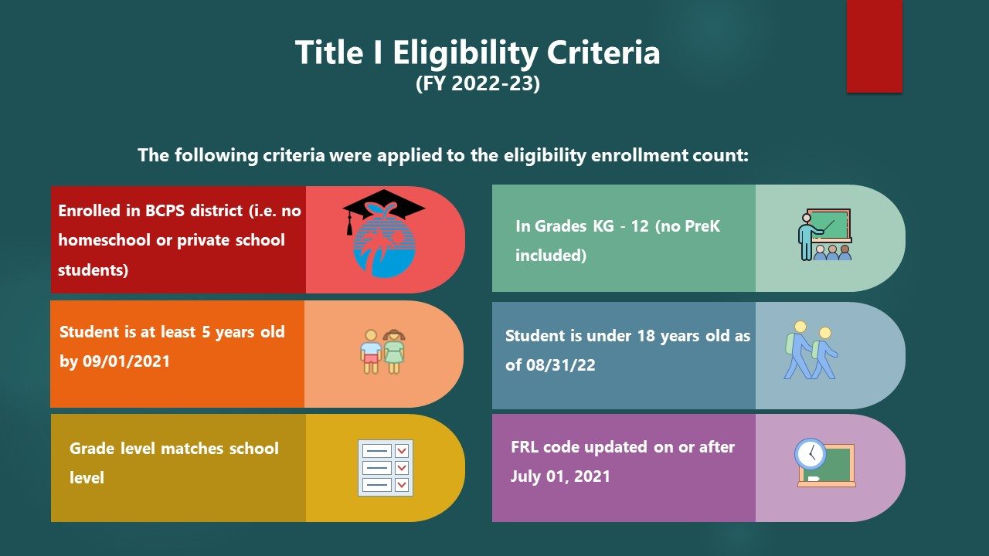

Slide 3
SCHOOL TITLE I STATUS
Prior to SY 2019-2020, Florida Department of Education (FLDOE) allowed BCPS to calculate School FRL percentages internally
FLDOE started new process in 2019-2020
FLDOE now uses Surveys 2 & 3 data to determine Free and Reduced lunch percentages
The impact of change was minimal
Date certain for FRL percentages
Location for Calculations
Historical Information
Notes:
At the start of the 2019-2020 school year, the Florida Department of Education instituted a new process for BCPS’ Title I eligibility determination
This change had minimal impact on us, because the criteria did not shift. What did shift was that:
The FRL percentages would now be calculated in the Spring
FLDOE would now perform the calculations

Slide 4
SCHOOL TITLE I STATUS
BCPS’ Title I Research Team (TI-RT) helps schools monitor their FRL progress in the weeks prior to Survey 2 (for new schools) and weeks + days prior to Survey 3 (for all schools)
Dashboard Updates
Ongoing Communication
Title I Program Managers
Memorandum
Historical Information
Notes:
BCPS runs internal calculations to support schools with their “actual” numbers
I use actual here because Historically, schools have had problems with:
Up to date lunch applications
Appropriate lunch codes for what the school has elected (CEP vs. Traditional)
Appropriate age ranges (based on Title I State policies)
The problems I’ve mentioned aren’t due to schools doing anything wrong, students move throughout the year, school serve younger and older students than the state allows, human error can lead to lunch applications having the wrong date etc.

Slide 5
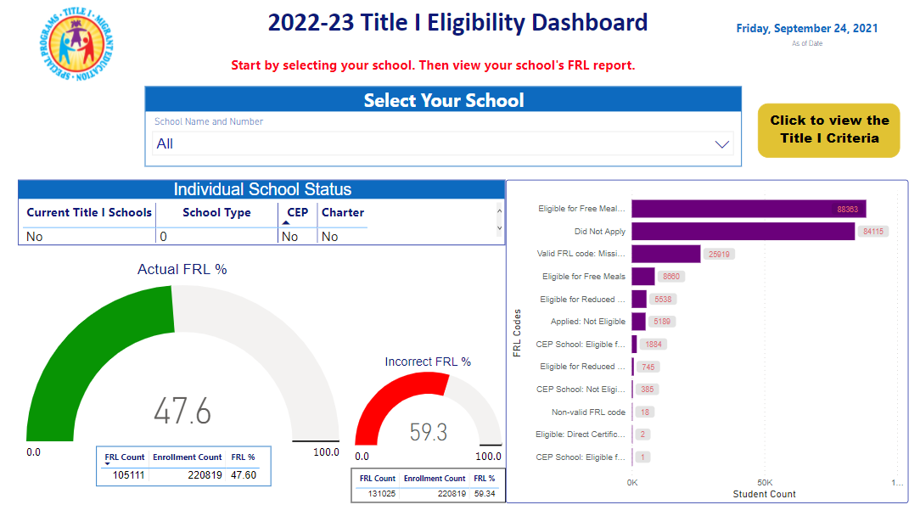
Snapshot of eligibility dashboard
Notes:
Here’s a snapshot of the Eligibility Dashboard. As you can see, BCPS personnel can access the dashboard and, by selecting their school, view what their actual vs. incorrect FRL percentage is
To the far right, you can see that it also lets them know where the incorrect codes might be. For instance, a school that has a “no” for CEP Status shouldn’t have any lunch codes for (CLICK) CEP School Eligible.

Slide 6
SCHOOL TITLE I STATUS
Updates(*)
For Survey 2
September 17, 2021
September 24, 2021
For Survey 3
January 10, 2022
January 17, 2022
January 24, 2022
January 31, 2022
Survey 3 closes on Feb. 7
(*)Available at the start of the next business day
Who can I contact for help?
Incorrect FRL Percentages
School Information Management Technician
I & T Service Desk Support
754 -321-0411
Food & Nutrition Services 754-321-0215
Title I Director
Luwando Wright
Luwando.wright@browardschools.com 754-321-1420
Title I Eligibility Dashboard
Mrs. Michelle Beason-Rahming
michelle.beasonrahming@browardschools.com
754-321-2549
Notes:
Highlight that this is date certain information, data availability won’t be until the start of the next business day

